Slide 1
Electronic Resource Overlap and Collection Analysis
Yoel Kortick
Senior Librarian
June 2025

Slide 2
Agenda
Introduction
Use Cases
Accessing the Overlap Analysis
Use Case One:
Compare one electronic collection in CZ to all of IZ
Use Case Two:
Compare one electronic collection in IZ to all of IZ
Use Case Three:
A comparison of a list of titles to all of the IZ

Slide 3
Introduction

Slide 4
Introduction
To achieve collection development analysis of libraries' electronic holdings, the Overlap Analysis Tool can be used to support multiple use cases.
Some of the main use cases are:
  When considering to order an electronic collection, which part of this electronic collection is already covered in other existing electronic collections. This can be used to avoid content overlap and purchasing of duplicate resources.
  When considering to cancel electronic collections, what full text access would be lost if a resource were cancelled.
  When the institution receives a file with a list of resources from a vendor which resources are and are not already in Alma.

Slide 5
Introduction
In this presentation we will look at several of these use cases.
For more information see Working with Overlap and Collection Analysis

Slide 6
Use Cases

Slide 7
Use Cases
Use Case One
A comparison of one electronic collection in the CZ to all of the IZ
Institution is considering purchasing a new electronic collection.
Before doing so institution can take an electronic collection from the Community Zone that it is considering purchasing and check to see if it has significant overlap with titles already owned by the institution.
In other words: does it make sense for the institution to purchase the electronic collection from the CZ? Does the institution already have access to the majority of titles via other providers?
  If there is a lot of overlap, then probably it is not recommended to purchase.
  If there is little or no overlap, then perhaps it is recommended to purchase.

Slide 8
Use Cases
Use Case One
E-Resources in Entire Institution Zone
E-Resources in Potential Specific Collection in Community Zone which institution may purchase
Overlap ?

Slide 9
Use Cases
Use Case Two A
A comparison of one electronic collection in the IZ to all of the IZ
Institution is considering canceling an existing (already purchased) electronic collection.
Before doing so the institution can take an electronic collection in the Institution Zone that it is considering canceling and check to see if it has significant overlap with all other titles already owned by the institution.
In other words: does it make sense for the institution to cancel the electronic collection? Will a lot of titles be lost because they are not in other electronic collections?
If there is a lot of overlap, then probably it is recommended to cancel.
If there is little or no overlap, then perhaps it is not recommended to cancel.

Slide 10
Use Cases
Use Case Two A
E-Resources in Entire Institution Zone
E-Resources in a Specific Collection in Institution Zone
Overlap ?

Slide 11
Use Cases
Use Case Two B
A comparison of one electronic collection in the IZ to a subset of the IZ
Institution is considering canceling an existing (already purchased) electronic collection.
Before doing so institution can take an electronic collection in Institution Zone that it is considering canceling and check to see if it has significant overlap with a subset of other titles already owned by the institution.
In other words: does it make sense for the institution to cancel the electronic collection? Will a lot of titles be lost because they are not in other electronic collections?
  If there is a lot of overlap, then probably it is recommended to cancel.
  If there is little or no overlap, then perhaps it is not recommended to cancel.

Slide 12
Use Cases
Use Case Two B
E-Resources in a subset of the Institution Zone
E-Resources in Specific Collection in Institution Zone
Overlap ?

Slide 13
Use Cases
Use Case Three
A comparison of a list of titles (identifiers of titles) to all of the IZ
Institution is considering purchasing the list of specific titles (which may be part of an electronic collection).
The vendor sends a list of titles to the institution (or the institution downloads a list from some source).
The institution compares the list of titles that it is considering purchasing and checks to see if it has significant overlap with titles already owned by the institution.
In other words: does it make sense for the institution to purchase the list of titles? Does the institution already have access to the majority of titles via other providers?
  If there is a lot of overlap, then probably it is not recommended to purchase.
  If there is little or no overlap, then perhaps it is recommended to purchase.

Slide 14
Use Cases
Use Case Three
E-Resources in Entire Institution Zone
E-Resources in list of titles
Overlap ?

Slide 15
Accessing the Overlap Analysis

Slide 16
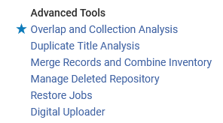
Accessing the Overlap Analysis
The Overlap Analysis is accessed at Alma Menu > Resources > Advanced Tools > Overlap and Collection Analysis.

Slide 17
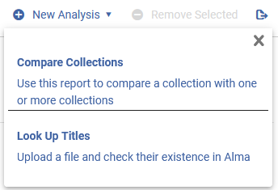
Accessing the Overlap Analysis
Click "New Analysis" and choose desired Analysis Type

Slide 18
Use Case One: Compare one electronic collection in CZ to all of IZ

Slide 19
Use Case One: Compare one electronic collection in CZ to all of IZ
In this example the institution is considering purchasing the electronic collection "Elsevier ScienceDirect eBooks Referex Miscellaneous" which exists in the Community Zone.
As part of the institution’s considerations, they want to know how many titles in this electronic collection
Already exist in the institution
Are unique (do not exist already in the institution)

Slide 20
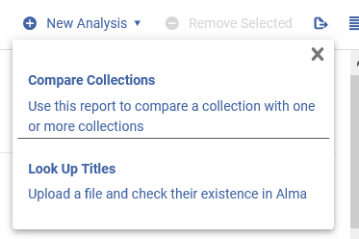
Use Case One: Compare one electronic collection in CZ to all of IZ
Choose "Compare Collections"

Slide 21
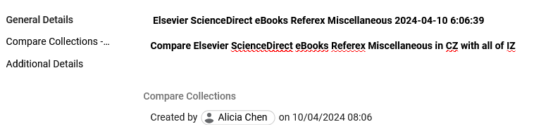
Use Case One: Compare one electronic collection in CZ to all of IZ
Give the analysis a name and description.
We have given description “Compare Elsevier ScienceDirect eBooks Referex Miscellaneous in CZ with all of IZ”

Slide 22
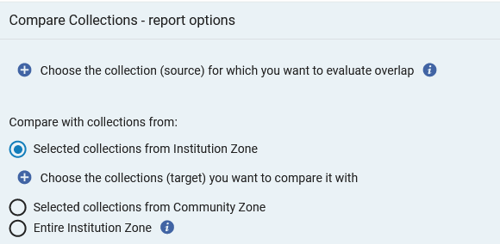
Use Case One: Compare one electronic collection in CZ to all of IZ
Choose the collection (source) for which you want to evaluate overlap

Slide 23
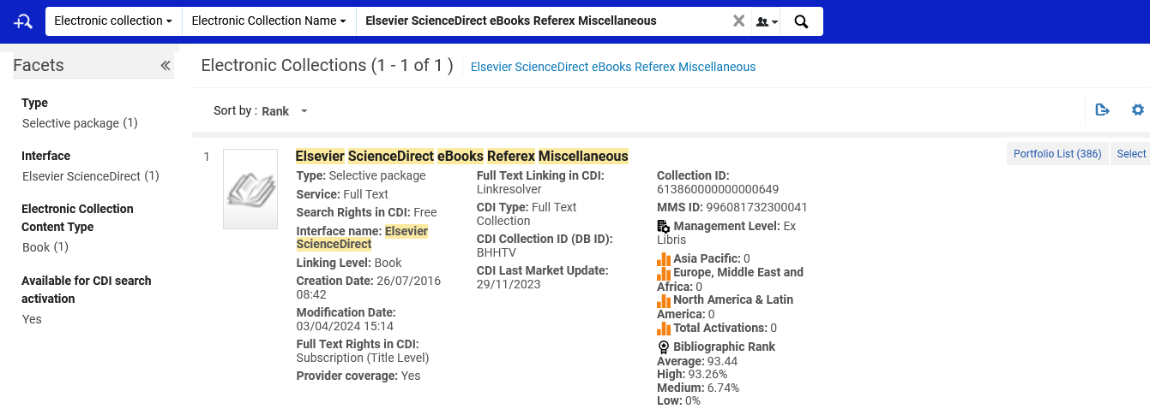
Use Case One: Compare one electronic collection in CZ to all of IZ
Search for and select the desired collection
Select
We are searching the CZ
Searching the CZ for electronic collection “Elsevier ScienceDirect eBooks Referex Miscellaneous”

Slide 24
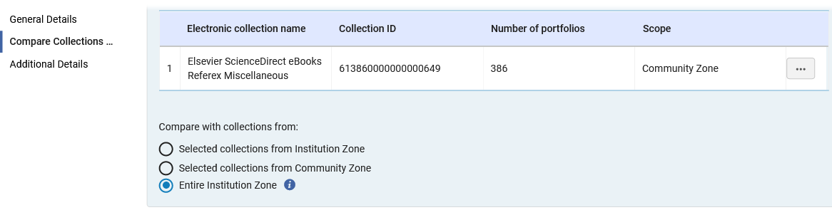
Use Case One: Compare one electronic collection in CZ to all of IZ
Choose the type of comparison. We will compare with the entire IZ

Slide 25
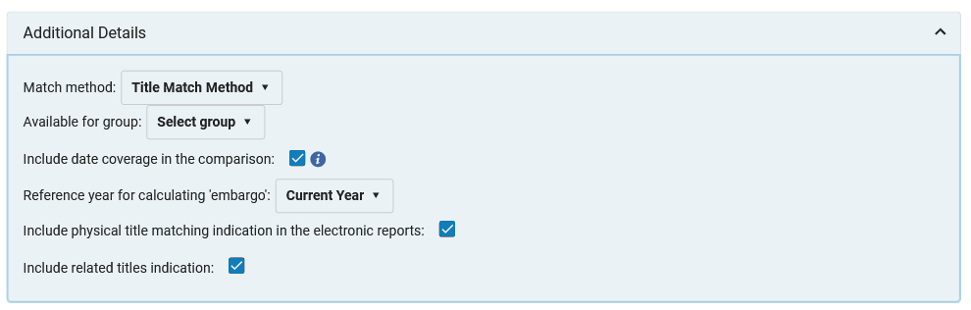
Use Case One: Compare one electronic collection in CZ to all of IZ
We are choosing:
  Match method by title
  Include date coverage as part of the overlap (particularly relevant for journals).
  Include physical title matching indication in the electronic reports
  Include related titles indication

Slide 26
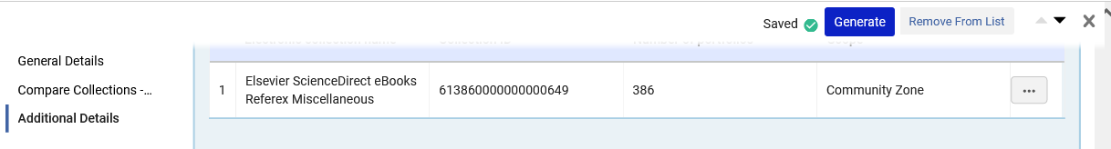
Use Case One: Compare one electronic collection in CZ to all of IZ
Click "Generate”

Slide 27
Use Case One: Compare one electronic collection in CZ to all of IZ
The analysis completes
We will view the report

Slide 28
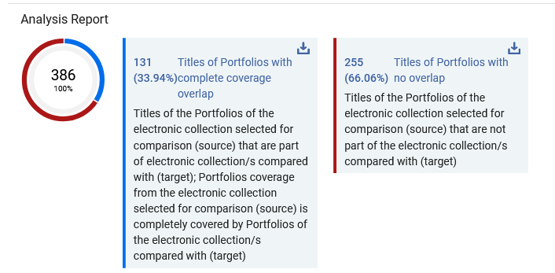
Use Case One: Compare one electronic collection in CZ to all of IZ
In the report we see that of the 386 titles in CZ collection "Elsevier ScienceDirect eBooks Referex Miscellaneous":
  131 titles (33.94%) have complete coverage overlap.
  255 titles (66.06%) have no overlap.

Slide 29
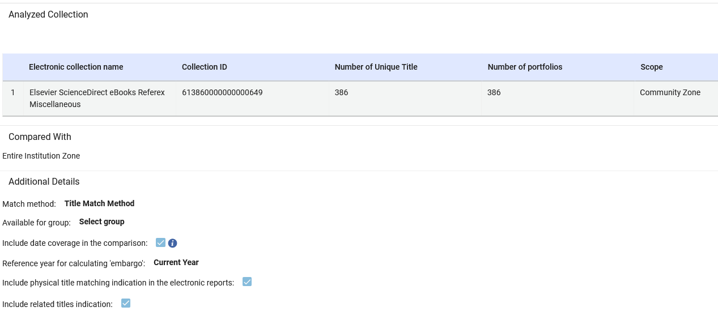
Use Case One: Compare one electronic collection in CZ to all of IZ
In the report we can also see exactly what was analyzed and how

Slide 30
Use Case One: Compare one electronic collection in CZ to all of IZ
From the analysis report we can download files of the titles which did have overlap and the titles which did not have overlap
Download titles which did have overlap
Download titles which did not have overlap

Slide 31
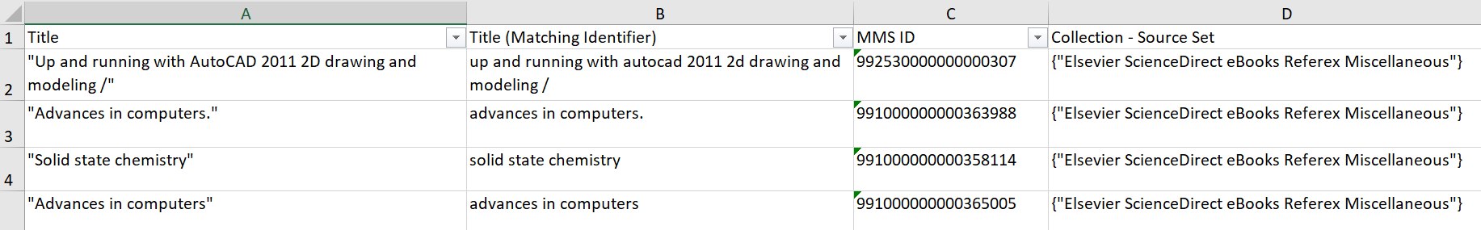
Use Case One: Compare one electronic collection in CZ to all of IZ
Here is (part of) file "Compare Collections - Titles of portfolios with complete coverage overlap.xlsx"
This is the "Identifier" because we chose "Title Match Method"
We will look at this example on the next slide

Slide 32
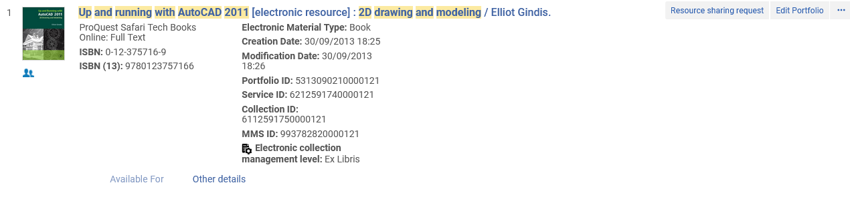
Use Case One: Compare one electronic collection in CZ to all of IZ
In our institution we already have portfolio “Up and running with AutoCAD 2011 2D drawing and modeling” and that is why it appears in the file "Compare Collections - Titles of portfolios with complete coverage overlap.xlsx"
We have it from a different electronic collection

Slide 33
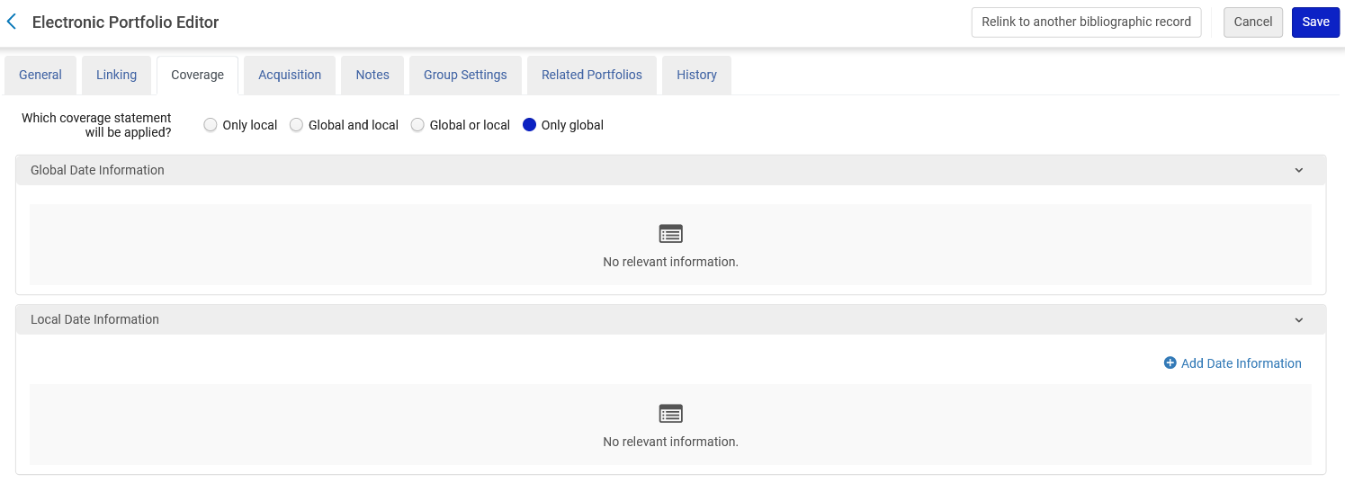
Use Case One: Compare one electronic collection in CZ to all of IZ
This electronic portfolio has nothing in the "coverage" tab that and means that all years are covered.

Slide 34
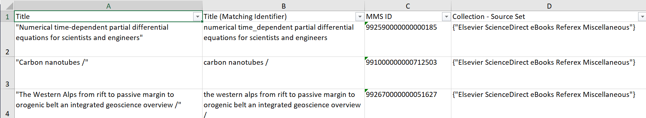
Use Case One: Compare one electronic collection in CZ to all of IZ
Here is (part of) file "Compare Collections - Titles of portfolios with no overlap.xlsx"
This is the "Identifier" because we chose "Title Match Method"
We will look at this example on the next slide

Slide 35
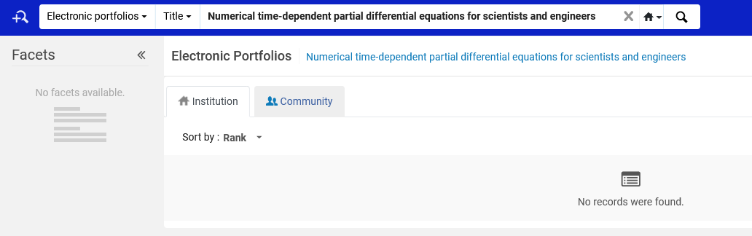
Use Case One: Compare one electronic collection in CZ to all of IZ
In our institution do not already have portfolio “Numerical time-dependent partial differential equations for scientists and engineers” and that is why it appears in the file "Compare Collections - Titles of portfolios with no overlap"

Slide 36
Use Case One: Compare one electronic collection in CZ to all of IZ
Now the institution needs to decide if they should purchase the electronic collection "Elsevier ScienceDirect eBooks Referex Miscellaneous"
As part of the decision-making process the institution now knows that
  131 titles (33.94%) have complete coverage overlap.
  255 titles (66.06%) have no overlap.
Thus: if the institution purchases this electronic collection, they will have 255 new titles.

Slide 37
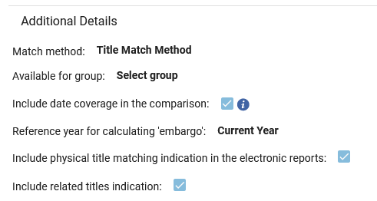
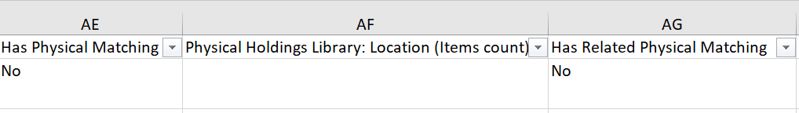
Use Case One: Compare one electronic collection in CZ to all of IZ
Note that because we chose this when running the job:
The output file "Compare Collections - Titles of portfolios with complete coverage overlap" has these fields:

Slide 38
Use Case Two: Compare one electronic collection in IZ to all of IZ

Slide 39
Use Case Two: Compare one electronic collection in IZ to all of IZ
In the example here the institution has already purchased and activated from the CZ the electronic collection "Taylor & Francis Library & Information Science Collection".
Now the institution is considering cancelling the subscription.
Before doing so the institution will first check to see what titles are unique to this collection and therefore would be lost if the subscription were cancelled.
The match method used will be by ISSN.

Slide 40
Use Case Two: Compare one electronic collection in IZ to all of IZ
Choose "Compare Collections"

Slide 41
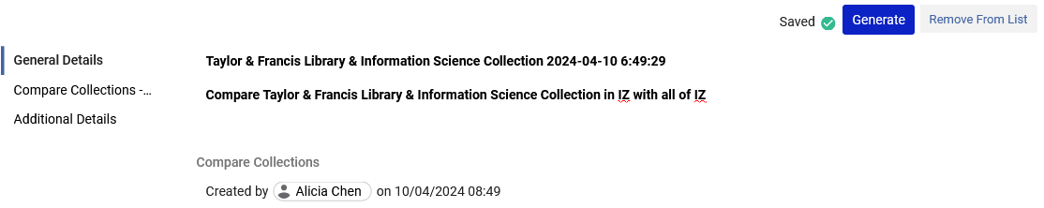
Use Case Two: Compare one electronic collection in IZ to all of IZ
Give the analysis a name and description.
We have given description “Compare Taylor & Francis Library & Information Science Collection in IZ with all of IZ”

Slide 42
Use Case Two: Compare one electronic collection in IZ to all of IZ
Choose the collection (source) for which you want to evaluate overlap

Slide 43
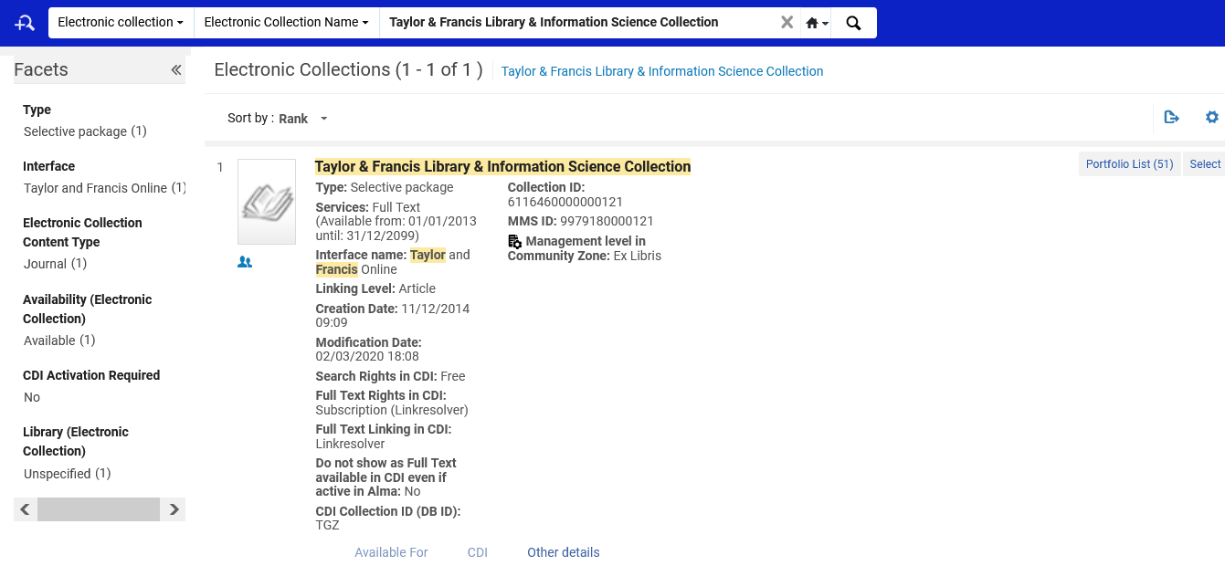
Use Case Two: Compare one electronic collection in IZ to all of IZ
Search for and select the desired collection
Select
We are searching the IZ
Searching the IZ for electronic collection “Taylor & Francis Library & Information Science Collection”

Slide 44
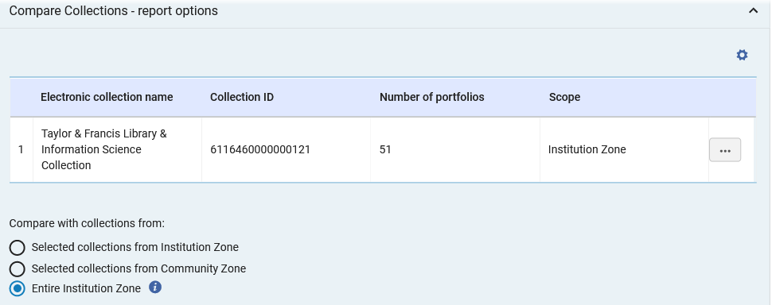
Use Case Two: Compare one electronic collection in IZ to all of IZ
Choose the type of comparison. We will compare with the entire IZ

Slide 45
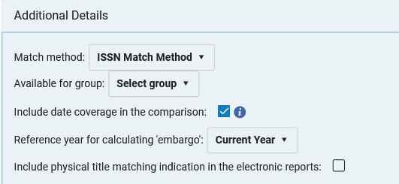
Use Case Two: Compare one electronic collection in IZ to all of IZ
Select the match method. We are choosing to match by ISSN.
Choose if you wish to include date coverage as part of the overlap.
Select Reference year for calculating ‘embargo’.

Slide 46
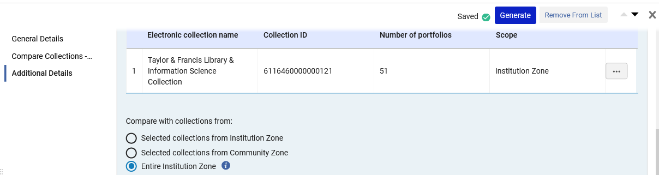
Use Case Two: Compare one electronic collection in IZ to all of IZ
Click "Generate"

Slide 47
Use Case Two: Compare one electronic collection in IZ to all of IZ
The analysis completes
Now we will view the report

Slide 48
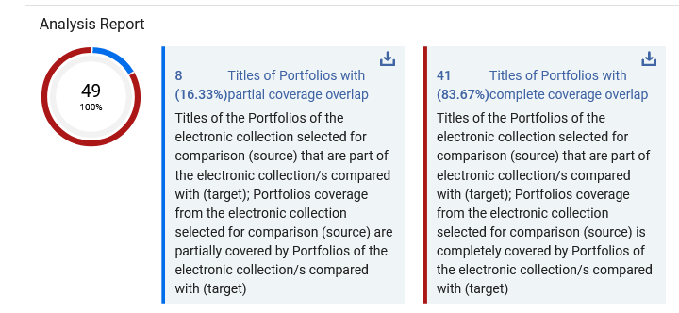
Use Case Two: Compare one electronic collection in IZ to all of IZ
Here we see that of the 49 titles in collection "Taylor & Francis Library & Information Science Collection", when comparing with the rest of the IZ:
8 titles (16.33%) have partial coverage overlap.
41 titles (83.67%) have complete overlap.
0 titles have no overlap (and that is why there is not a separate entity for it below)

Slide 49
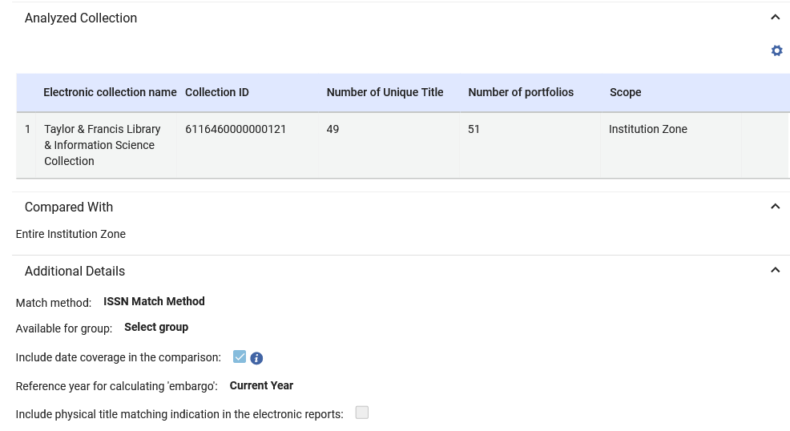
Use Case Two: Compare one electronic collection in IZ to all of IZ
In the report we can also see exactly what was analyzed

Slide 50
Use Case Two: Compare one electronic collection in IZ to all of IZ
From the analysis report we can download files of the titles which had partial and complete overlap
Download titles which have partial coverage overlap
Download titles which have complete coverage overlap

Slide 51
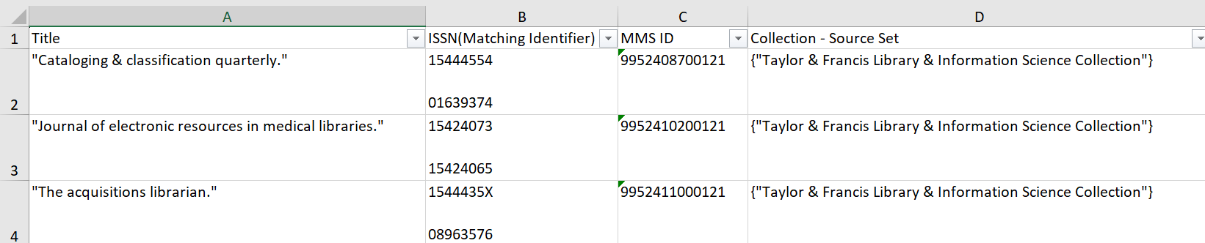
Use Case Two: Compare one electronic collection in IZ to all of IZ
Here is (part of) file "Compare Collections - Titles of portfolios with partial coverage overlap.xlsx"
This is the "Identifier" because we chose “ISSN Match Method"

Slide 52
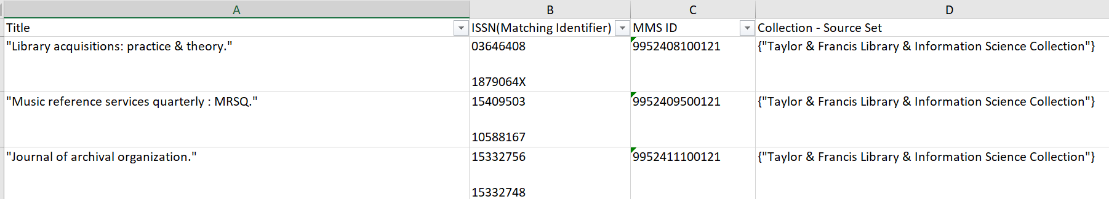
Use Case Two: Compare one electronic collection in IZ to all of IZ
Here is (part of) file "Compare Collections - Titles of portfolios with complete coverage overlap.xlsx"
This is the "Identifier" because we chose “ISSN Match Method"
We will look at this example on the next slide

Slide 53
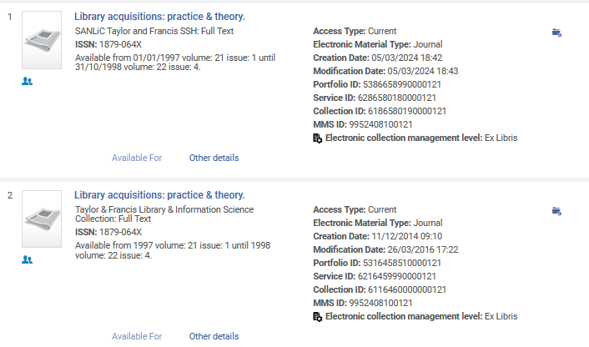
Use Case Two: Compare one electronic collection in IZ to all of IZ
Title "Library acquisitions: practice & theory." ISSN 03646408 was in file "Compare Collections - Titles of portfolios with complete coverage overlap.xlsx“. We see here that we have “complete coverage” overlap from a different electronic collection
In electronic collection SANLiC Taylor and Francis SSH we have coverage from 01/01/1997 volume: 21 issue: 1 until 31/10/1998 volume: 22 issue: 4.
In electronic collection Taylor & Francis Library & Information Science Collection we have coverage from 1997 volume: 21 issue: 1 until 1998 volume: 22 issue: 4.

Slide 54
Use Case Two: Compare one electronic collection in IZ to all of IZ
Now the institution needs to decide if they should cancel the electronic collection "Taylor & Francis Library & Information Science Collection"
As part of the decision-making process the institution now knows that
  8 titles (16.33%) have partial coverage overlap.
  41 titles (83.67%) have complete overlap.
  0 titles have no overlap
Thus: if the institution cancels this electronic collection, they will lose partial coverage for 8 titles.

Slide 55
Use Case Three: A comparison of a list of titles to all of the IZ

Slide 56
Use Case Three: A comparison of a list of titles to all of the IZ
In the scenario here the institution has received a list of titles from the vendor.
The file has a column with the title and a column with the ISSN.
We will upload the file and compare it to what we have already in the institution, thereby we will be able to know:
  Which titles in the input file we already have
  Which titles in the input file we do not already have
We are comparing by ISSN. For a list of other identifiers which can be used for comparison see Excel File Containing Identifiers for Comparison at Performing Look Up Titles Analysis .

Slide 57
Use Case Three: A comparison of a list of titles to all of the IZ
Here is our input file
eISSN/ISSN | Title
1873-1848 | Library & information science research.
1876-0562 | Library and information science.
2224-1574 | 图书馆学与资讯科学/#/圖書館學與資訊科學 [[T'U Shu Kuan Hsueh Yu Tzu Hsun K'O Hsueh]]
1023-2125 | 图书与资讯学刊/#/圖書與資訊學刊 [[T'U Shu Yu Tzu Hsun Hsueh K'An]]
2218-3388 | 图书资讯学研究/#/圖書資訊學研究 [[T'U Shu Tzu Hsun Hsueh Yen Chiu]]
1394-6234 | Malaysian journal of library & information science.
0795-4778 | African journal of library, archives & information science.
0795-4778 | African journal of library, archives & information science.
1680-4465 | Pakistan journal of library & information science : PJLIS.
2328-2967 | Journal of education for library and information science / ALISE, Association for Library and Information Science Education.
2249-0213 | International research : journal of library and information science.
2328-2967 | Journal of education for library and information science / ALISE, Association for Library and Information Science Education.
2249-0213 | International research : journal of library and information science.
1234-5678 | Library Science Monthly
2345-6789 | Library Science Quarterly
3456-7890 | Library Science Yearly
9876-5432 | Librarianship Monthly
8765-4321 | Librarianship Quarterly
7654-3210 | Librarianship Yearly
7654-323423 | Librarianship Yearly

Slide 58
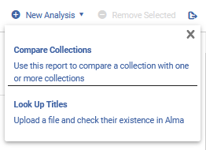
Use Case Three: A comparison of a list of titles to all of the IZ
We will again run the "Overlap and Collection Analysis" and this time we will choose "Look up titles"

Slide 59

Use Case Three: A comparison of a list of titles to all of the IZ
We give the report a name and description

Slide 60
Use Case Three: A comparison of a list of titles to all of the IZ
We will now do as follows:
Upload a file called "Input file from vendor A Chen Publishers.xlsx"
In the section "Select the populations you would like to compare the titles from the input file with:" we will choose "Institution Zone Electronic Resources (including Community Zone activated resources)
In the section "Choose the report out format" choose "One excel line per match"
We will not select "Include physical title matching indication in the electronic reports
Click "Generate"

Slide 61
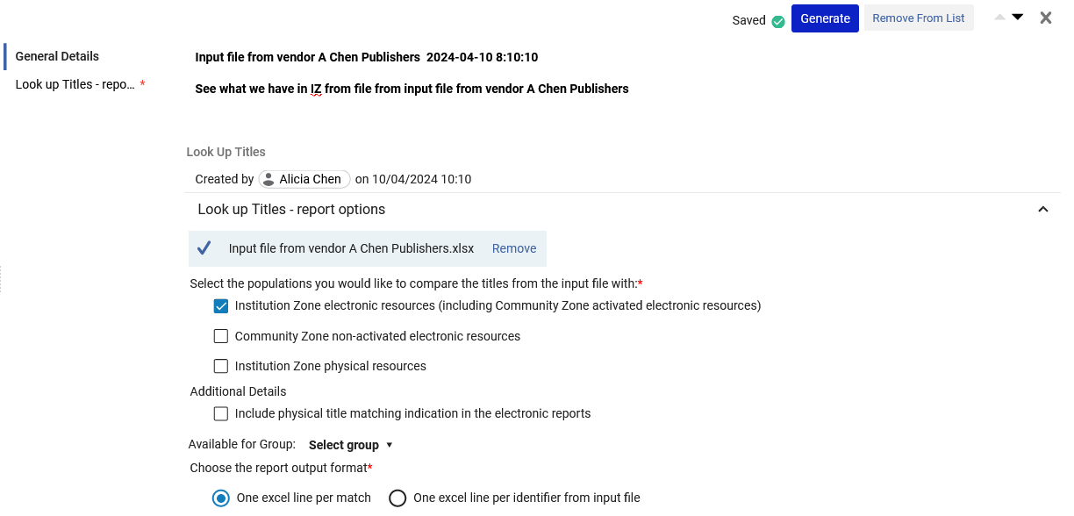
Use Case Three: A comparison of a list of titles to all of the IZ

Slide 62
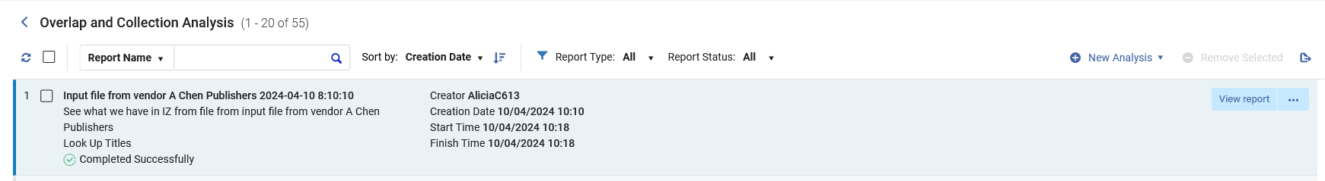
Use Case Three: A comparison of a list of titles to all of the IZ
The job completes and we will view the report

Slide 63
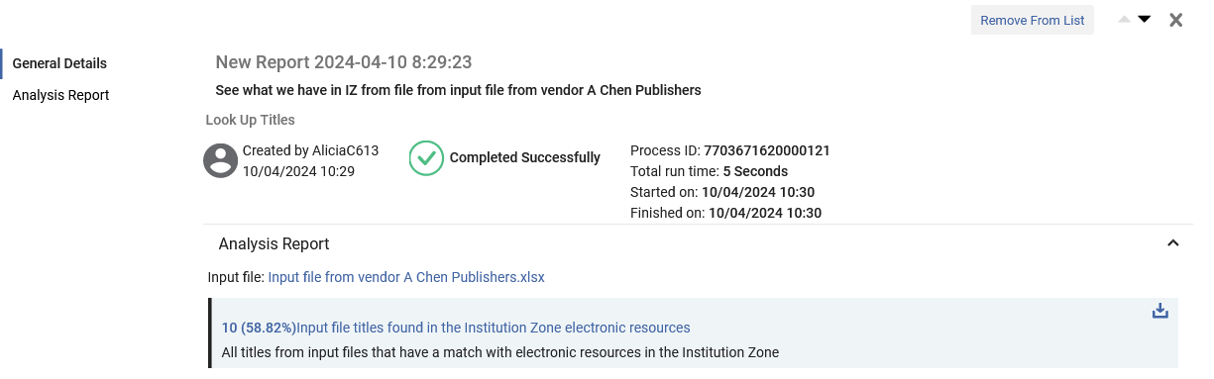
Use Case Three: A comparison of a list of titles to all of the IZ
In the output see that it states "10 (58.82%) Input file titles found in the Institution Zone electronic resources". Download the file.

Slide 64
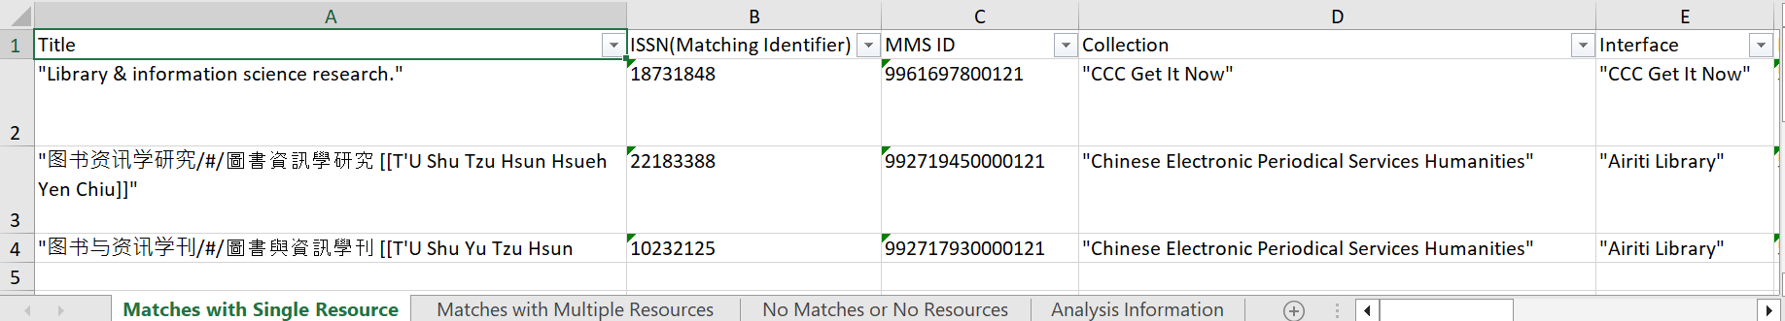
Use Case Three: A comparison of a list of titles to all of the IZ
See that the output file "Look Up Titles - Institution Zone electronic resources" has four tabs for:
  Matches with Single Resource
  Matches with Multiple Resources
  No Matches or No Resources
  Analysis Information (includes the parameters which were used in the jobs)

Slide 65
Use Case Three: A comparison of a list of titles to all of the IZ
Here is an example from "Matches with Single Resource"

Slide 66
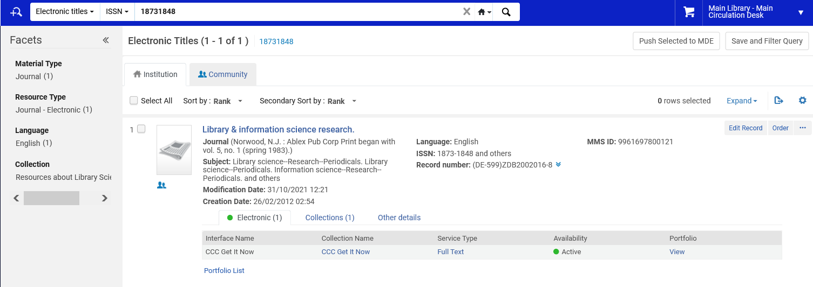
Use Case Three: A comparison of a list of titles to all of the IZ
Here is the example in Alma from "Matches with Single Resource"
Single resource

Slide 67
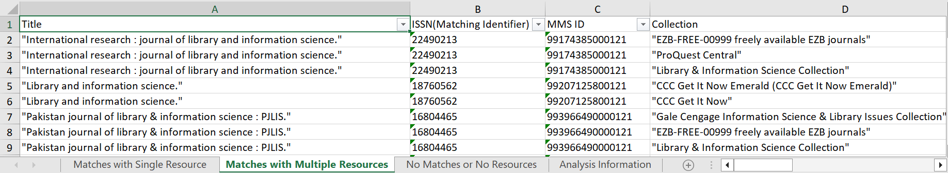
Use Case Three: A comparison of a list of titles to all of the IZ
Here is an example from "Matches with Multiple Resources"

Slide 68
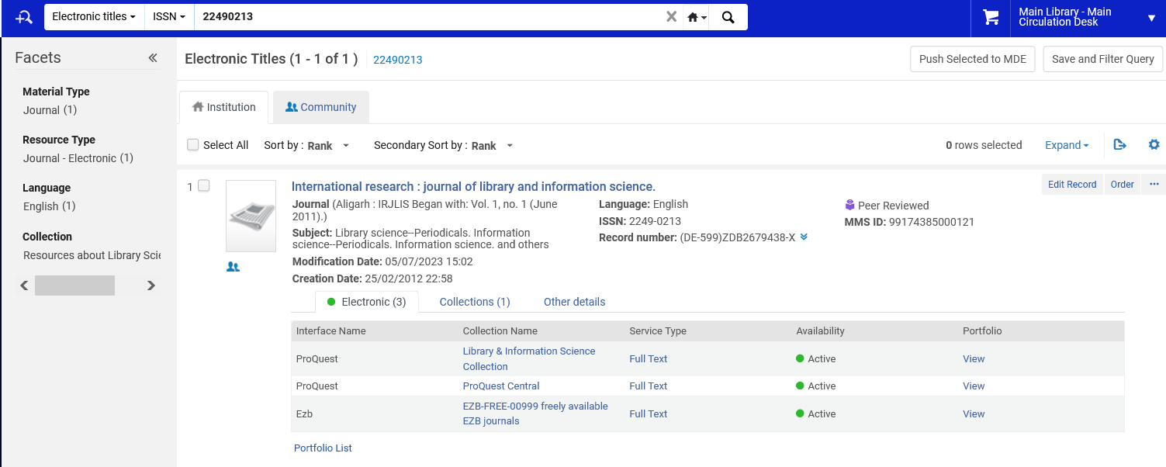
Use Case Three: A comparison of a list of titles to all of the IZ
Here is the example in Alma from "Matches with Multiple Resources"
3 resources

Slide 69
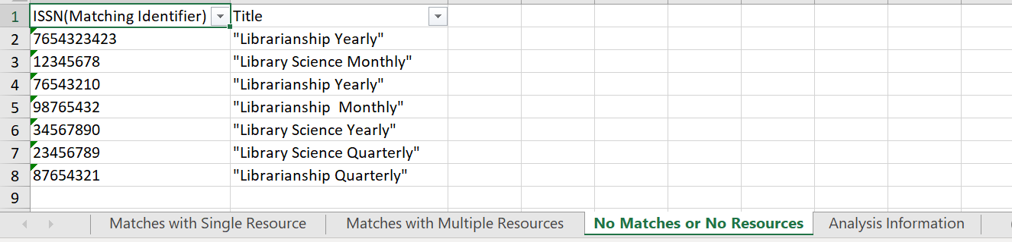
Use Case Three: A comparison of a list of titles to all of the IZ
Here is an example from “No Matches or No Resources"

Slide 70
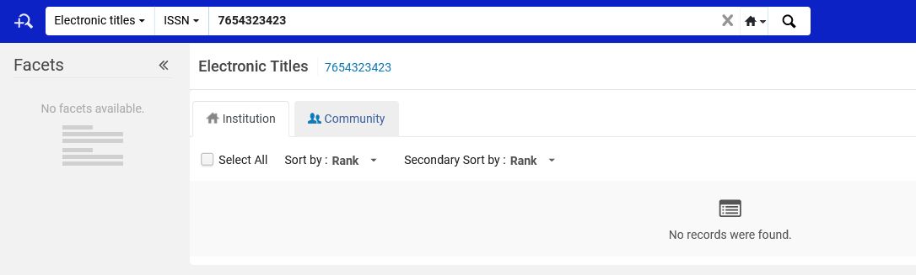
Use Case Three: A comparison of a list of titles to all of the IZ
Here is the example in Alma from "No Matches or No Resources"

